Slide 1
Pedagogical Recycling
Tiffany Johnson – SI 2013

Slide 2
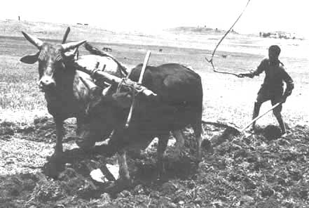
Importance of Analysis – Angie Burton
Social Studies Class
I started using pictures in social studies as writing into the day activities to use as formative assessments. In this particular one, I was trying to assess whether my students understood the basic concept of types of economies by identifying which economy this picture most likely came from. This activity immediately gave me an idea of which students had grasped the concept from the previous day.

Slide 3
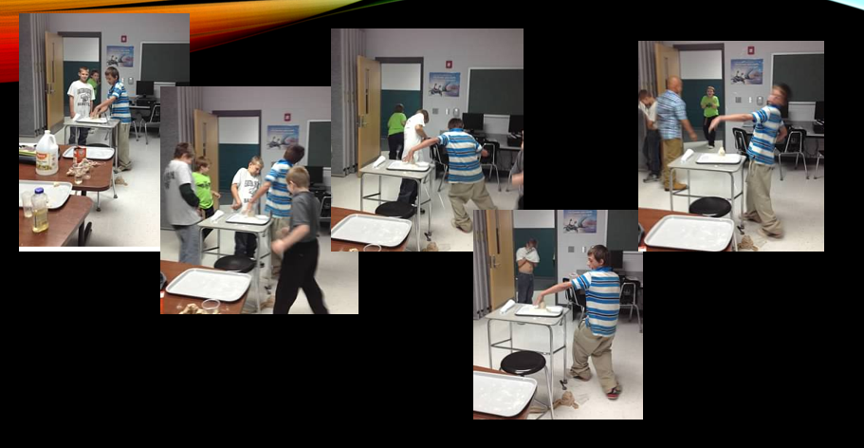
Experiential Writing – Erin
Volcanic Explosions
What’s a hypothesis and how do we record results?
Beginning of the year introductory activity to the scientific method
Succes? YES!

Slide 4
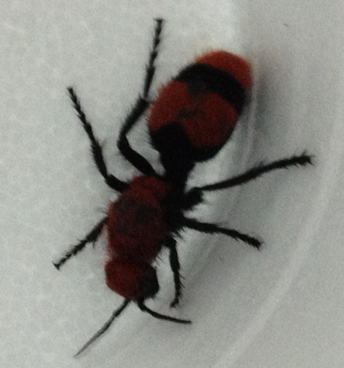
Using the Environment… - Vivian Bowles
Science class outside to answer the question – What is inquiry and investigation?
Check out the cool finds my kids found. They had a chance to write down their questions and research to find the answers!
http://1314ftms.weebly.com/science.html

Slide 5
Glogs Away! - Jared
Write a paper about the five themes of geography? NO THANKS!
We used Glogsters to demonstrate what we knew about our five themes!
http://1314ftms.weebly.com/social-studies.html

Slide 6
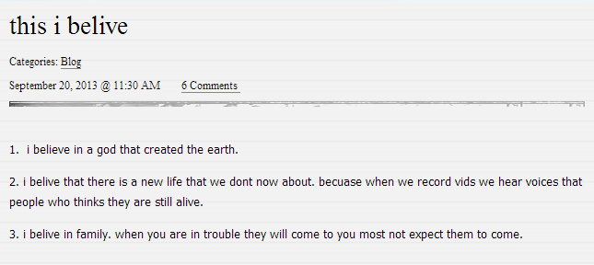
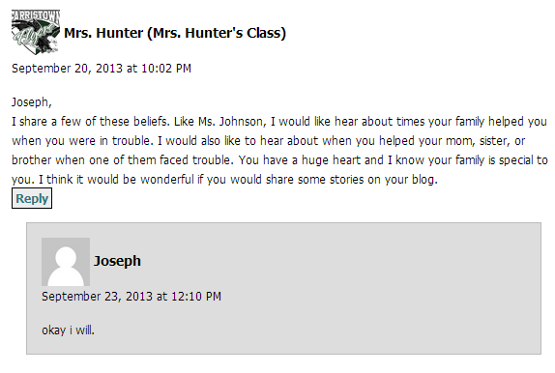
Blogging Beliefs – Jared/Eddie
Using Kidblog as a prewriting activity
Received feedback from the principal and her English class
Kids involved? You bet!
http://kidblog.org/MsJohnsonsClass-36/

Slide 7
Prewriting Madness - Eddie
This I Believe
A week of prewriting demonstrated to me that my kids were not ready to write about their personal beliefs.
Prewriting saved me a lot of time and frustration by giving me an idea of where my kids were on this topic.

Slide 8
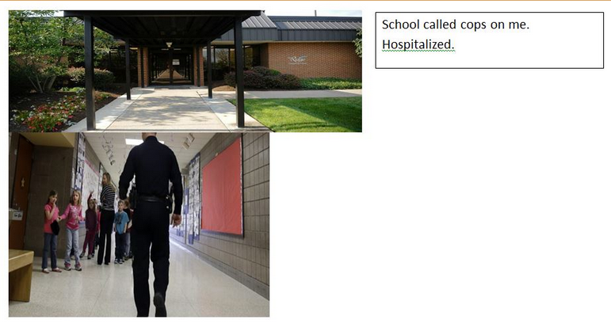
Connecting Illustrating…- Caitlyn
In a twist…students found pictures that represented who they believed they were to create a six word memoir.
http://1314ftms.weebly.com/language-arts.html
Also used when writing longer memoirs as a tool for writer’s block.

Slide 9
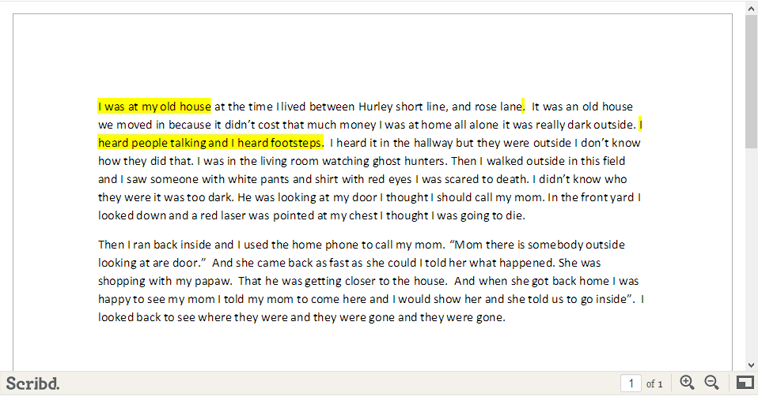
Using Weebly - Markita
Students set up a weebly site to publish their work.
Haven’t used it extensively, but gave them a way to publish a piece of their writing for the rest of us to view.
http://1314ftms.weebly.com/class-websites.html

Slide 10
Using Rubrics and MGP – Lee/Yours Truly
Current Assignment
In lieu of a research paper, students are doing research and presenting it through a multigenre project.
I tweaked my own assignment and gave them choices of genres to get them thinking in new ways.
I was easily able to find and adjust a rubric online to use as a grading tool and as a way to let student’s know the specific expectations for the project up front.

Slide 11
The Writing Marathon
FTMS School Wide Writing Marathon
Easy to organize
Exciting to implement!
http://www.ekuwritingproject.org/directors-blog.html

